Slide 1

Trinity Oaks Curriculum Night
Tuesday, November 18, 2014
Thank you for coming!

Slide 2
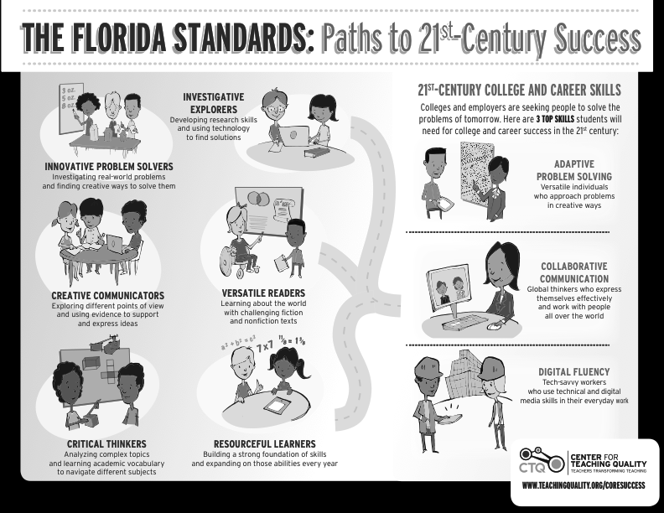
Notes:
Allison

Slide 3
Notes:
Robin

Slide 4
Standards - Math
Why do we teach so many strategies?!?!
  Teaching a variety of strategies allows the students to see that there are multiple ways to solve the same problem.
  It also allows the students to understand math concepts, and actually LEARN why the algorithm works. We want them to problem solve, think, and understand, not just do!
  Using the standard algorithm with understanding is the goal!
Notes:
Students who understand the concept have flexibility with strategies- they don’t just know how to do one “trick”.

Slide 5
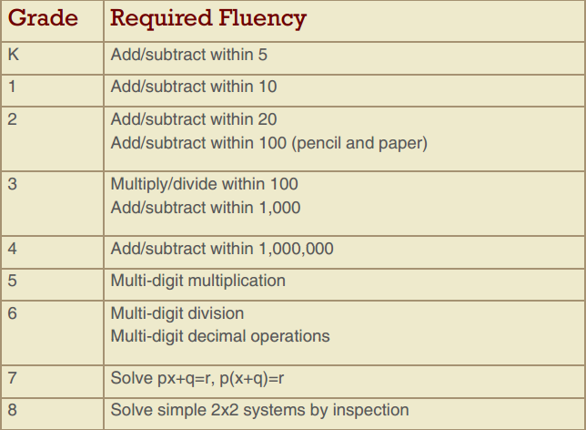

Slide 6
Standards - ELA
Notes:
Katrina

Slide 7
ELA - Writing
Writing Expectations:
  Types of Writing: Narrative, Informative, Opinion (FSA will be Informative or Opinion)
  Rubric:
    Purpose, Focus, and Organization
    Evidence and Elaboration
    Conventions of Standard English
Notes:
Katrina

Slide 8
FSA
3rd Graders:
  March 25-26: ELA
  April 1-2: Math
  Both have Multiple Choice, Extended Response
  Both are Paper/Pencil
  Students must achieve a level 2 in ELA in order to be promoted to 4th grade.
  If a student scores a level 1 in ELA, the SAT-10 will be administered and may be used for promotion.
  Good Cause portfolios may also be used; collection will begin in late January.
Notes:
Billie

Slide 9
FSA
4th Graders:
  March 2nd: Writing
    Paper/Pencil, 90 minutes (120 if needed)
    Students read texts, respond to prompt using texts to support their writing.
    Informative or Opinion
  March 25-26: ELA
  April 1-2: Math
    Both are Paper/Pencil.
    Both have Multiple Choice, Extended Response
  Scores are not used for promotion to 5th grade.

Slide 10
FSA
5th Graders:
  March 2nd: Writing
    Paper/Pencil, 90 minutes (120 if needed)
    Students read texts, respond to prompt using texts to support their writing.
    Informative or Opinion
  April 13-14: ELA Computer based
  April 20-21: Math Computer based
    Both are Multiple Choice, Extended Response
  April 27-28: FCAT Science2.0 Paper/Pencil
  Scores are not used for promotion to 6th grade.

Slide 11
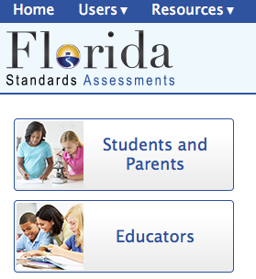
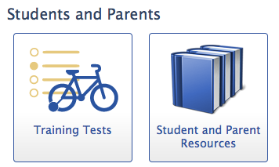
FSA Examples
FSA Website: www.fsassessments.org
  This website provides Reading and Math training tests for practice.
  Parents may access, students may practice!
Notes:
Darlene

Slide 12
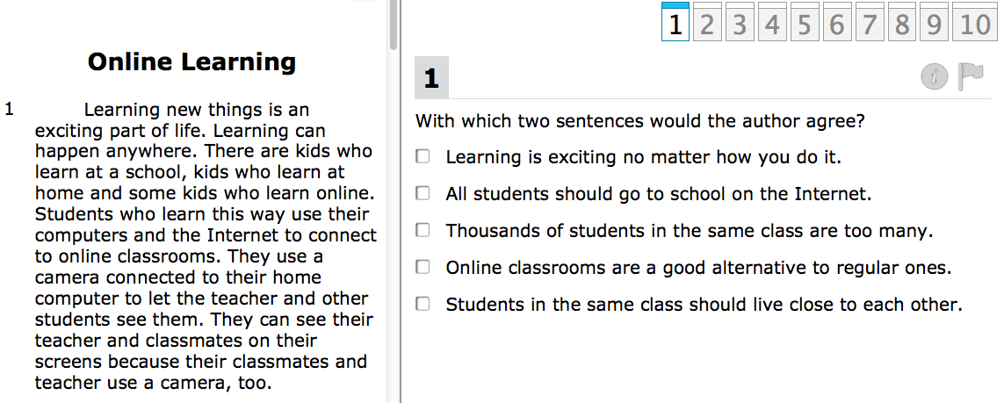
ELA Examples
Notes:
From the 3rd /4th grade ELA practice test. Shows picking 2 sentences.

Slide 13
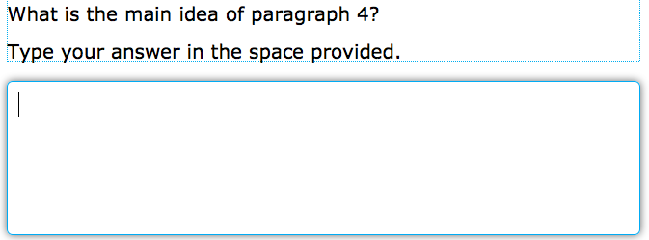
Notes:
Shows an extended response box- 5th grade is only grade computer based!

Slide 14
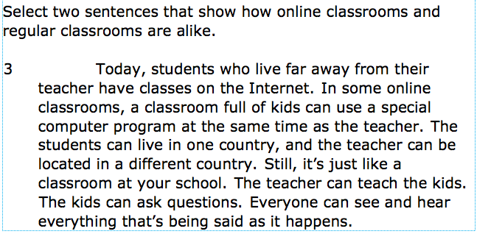
Notes:
Shows “choose two” again.

Slide 15
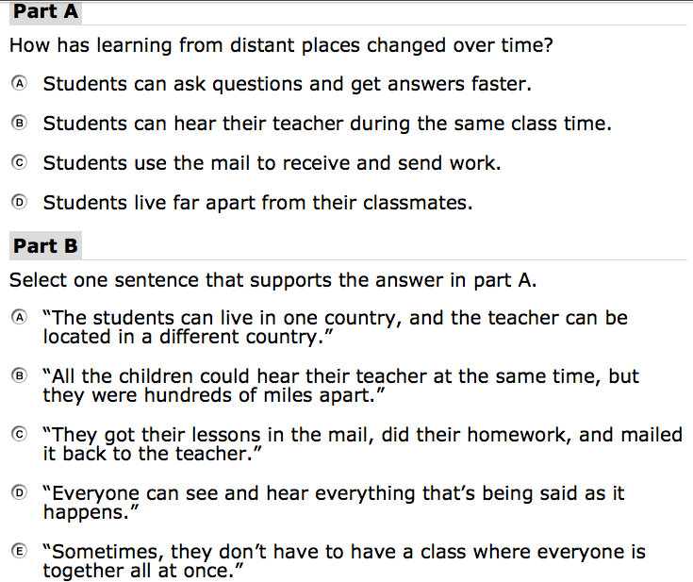
Notes:
Shows part A/ Part B test item- this is from 3rd 4th grade test.

Slide 16
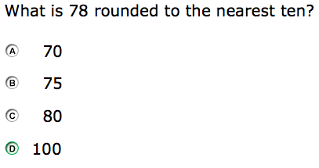
Math Examples
Notes:
Dennis
3rd grade test, multiple choice

Slide 17
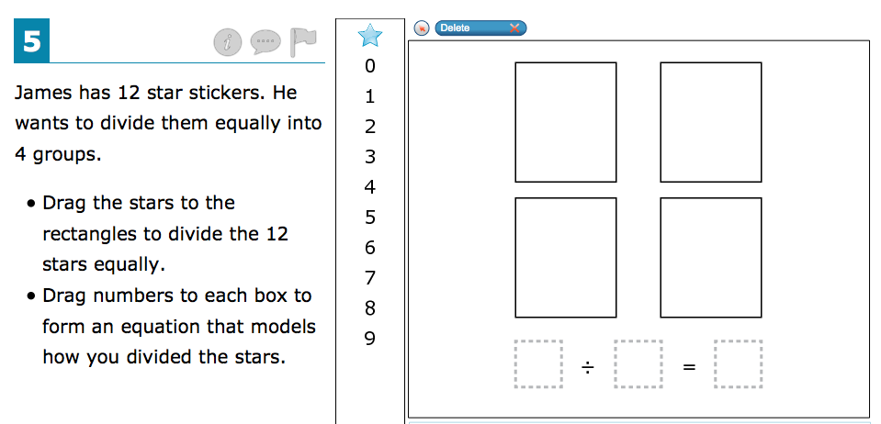
Notes:
3rd -4th grade test- shows creating an equation.

Slide 18
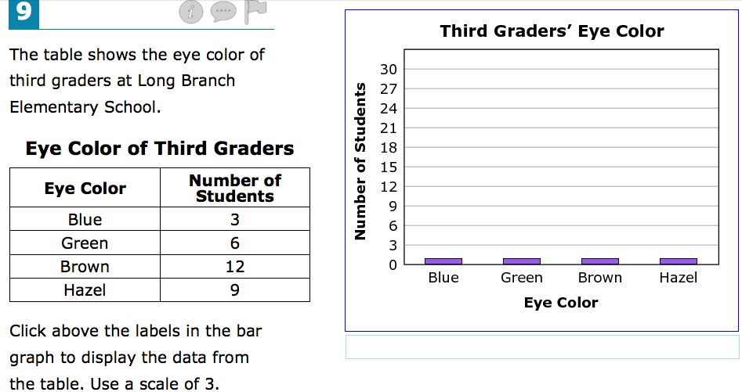
Notes:
3rd-4th grade- shows interactive bar graph

Slide 19
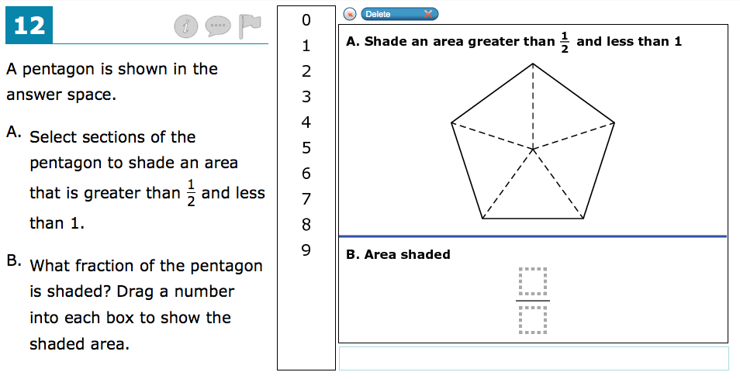

Slide 20
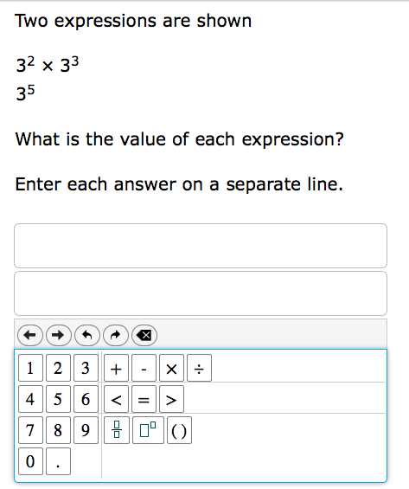
Notes:
5th- 6th test- shows 2 part answer.

Slide 21
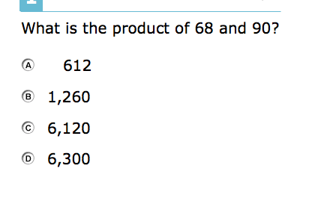

Slide 22
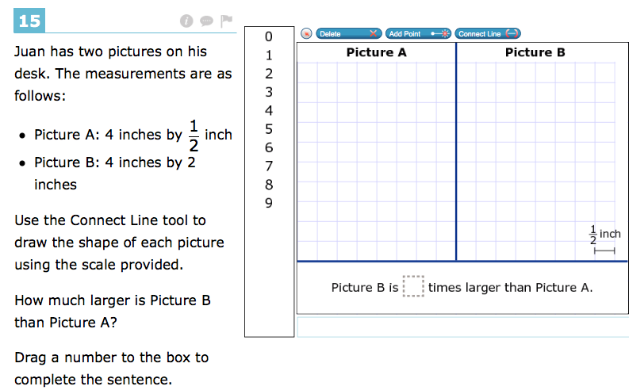
Notes:
5th- 6th test

Slide 23

How we use results…
Examine individual student strengths, in comparison to peer group
Examine overall school trends, identify areas for improvement
Examine effectiveness of instructional and intervention efforts

Slide 24

Parents are Teachers, too!
How you can help at home…
Math
  Visit the Think Central Website or other teacher recommended websites.
  Look over papers / work brought home
  Review missed problems on HW or assessments
  Basic math facts flashcards (addition
  & subtraction, multiplication)
Notes:
Sandy

Slide 25

Parents are Teachers, too!
How you can help at home…
ELA
  PRACTICE makes perfect
  Read and discuss a wide variety of texts, topics, and sources.
  Review assignments brought home.
  Discuss books with your child. What is happening? Why? What connections can be made to other texts?
  Provide opportunities for your child to write about the text he/she is reading.
Notes:
Sandy

Slide 26

Parents are Teachers, too!
How you can help at home…
Science (5th grade)
  Assessment includes standards from 3rd-5th
  Think Central interactive labs, videos, resources
  Utilize teacher website resources
  Students need to review Interactive Science Notebooks to study before assessments.

Slide 27

THANK YOU!
We appreciate you, and all you do do support your child’s education!
If you have questions, please follow up with your child’s teacher.

