Slide 1
Volunteer Programs
Volunteer Orientation

Slide 2
Purpose
To build relationships between schools, parents, community members and business partners.
To promote parent and community involvement, focusing on creating opportunities to increase engagement within our schools.

Slide 3
Florida Statute
Required by Florida Statute 943.04351
…A state agency, before making any decision to appoint a person, whether for compensation or as a volunteer, must conduct a search of that person’s name or other indentifiying information against the registration information regarding sexual predators and sexual offenders...

Slide 4
General Principles
The Volunteer Programs office operates with the approval of Pasco County Schools and is guided by the principles and policies of the district.
Volunteers are non-paid members of the community functioning under the guidance of Pasco County Schools.
Volunteers are to serve only in an auxiliary capacity under the direction and supervision of professional school personnel.
Volunteers should provide supplemental and supportive services and are not a substitute for a member of the school staff.

Slide 5
General Principles
Pasco County Schools encourages volunteer participation by individuals and groups in local schools and district offices.
Volunteers can be utilized for classroom help, school events, field trips and other school sponsored off-campus activities.
Volunteering can be before, during and after school hours.
Volunteers who breach confidentiality or do not follow the policies and procedures, as outlined in the Volunteer Guidelines, will have their volunteer privileges revoked.

Slide 6
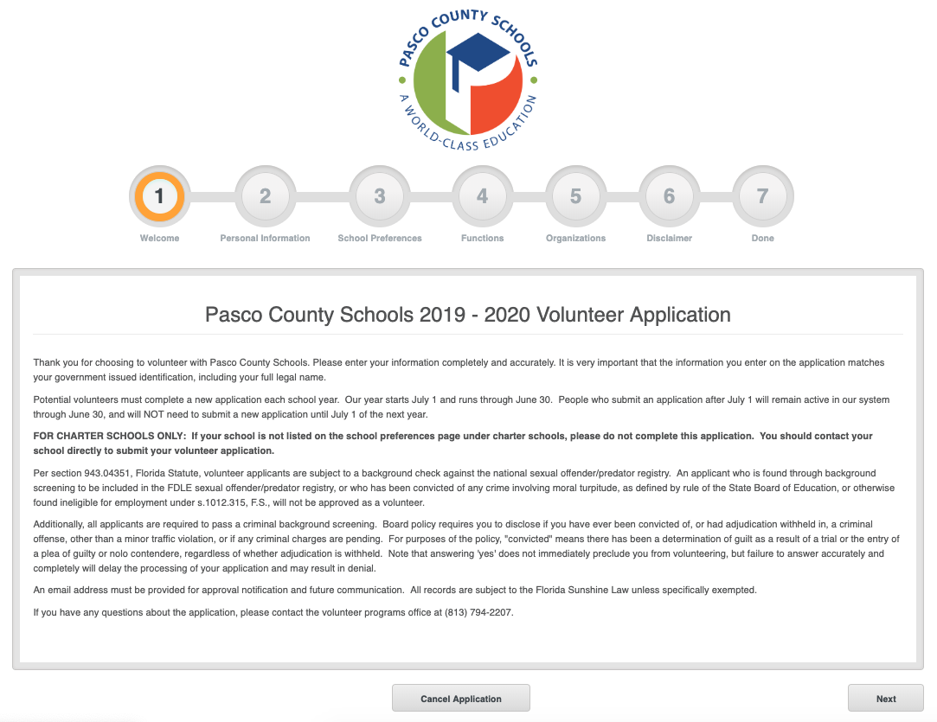
Application Process
Online application process: www.pascoschools.org
From the district main page
Remember: A new application must be submitted each year, on or after July 1.

Slide 7
Volunteer Opportunities
Designated volunteer opportunities:
Athletics/Cheerleading
Band/Chorus/Drama
Book Fair
Cafeteria
Carnival/Dance/Festival
Classroom Helper
Clothes Closet/Food Pantry
Club Sponsor
Concessions
Early Childhood – HS/EHS/PK
Field Trip Chaperone
Heath Screenings
Media Center
Mentor
Odyssey of the Mind
Office Helper
PTA/PTO
SAC – School Advisory Council
Translator/Interpreter
Tutor
Watch D.O.G.S.

Slide 8
Volunteer Expectations
As an important part of Pasco County Schools, volunteers are expected to be a positive role model and supportive of district initiatives.
Along with professional, appropriate
behavior, volunteers should also
adhere to the expectations outlined
in the Volunteer Guidelines.

Slide 9
Volunteer Expectations
Supervision
Volunteers shall work under the direction and supervision of the principal, teacher(s) or other members of the school staff.
Volunteers provide supplemental and supportive services and are not a substitute for a member of the school staff.
Volunteers may not supervise a class in the teacher’s absence.

Slide 10
Volunteer Expectations
Accountability
Volunteers must always sign in and out and wear their Pasco County Schools volunteer identification badge on school property.
Volunteers should not wander around campus, they should report to and remain in their assigned volunteer area.
Volunteers should not visit their child’s classroom, unless it is part of their volunteer assignment.
Volunteers should learn where fire exits are located and be familiar with the school’s emergency procedures and crisis response plan.

Slide 11
Volunteer Expectations
Confidentiality
Volunteers may come in contact with student information in the course of their duties. By Pasco County Schools policy, volunteers must keep information learned about students confidential.
Volunteers are advised they are required to maintain strict confidentiality with all school or classroom information and shall agree in writing that they will comply with the requirement.
Volunteers may not have access to the student information system or cumulative records unless they have principal permission and clearly understand the need for confidentiality of student records.

Slide 12
Volunteer Expectations
Professionalism
The relationship between volunteers and the school staff must be one of mutual respect, confidence and consideration.
Volunteers should maintain a professional attitude and adhere to school policies and procedures.

Slide 13
Volunteer Expectations
Dress Code
Dress codes are established at each school. School administrators have the authority to enforce the dress code as needed.
Volunteers should dress neatly and professionally. Clothing and shoes should be such that the volunteer will be comfortable and safe.
As with students, attire that advertises drugs or alcoholic beverages, or that is vulgar or obscene in nature, is not permitted.
Volunteers who fail to use safety devices or disregard the dress code may be removed from the list of approved volunteers.

Slide 14
Volunteer Restrictions
While volunteers can offer many valuable skills, there are some limitations on volunteer duties. The following list describes activities that volunteers are not authorized to do.
Volunteers may not:
establish instructional objectives.
grade subjective assignments that result in a grade for the student or are considered a formal assessment of the student’s achievement or ability.
work with students before or after the school day unless part of an authorized Pasco County Schools program.

Slide 15
Volunteer Restrictions
Volunteers may not:
take students off campus during the day, by any means, including walking or driving, unless special permission has been granted by the principal. The volunteer must be accompanied by a faculty/staff member. If the volunteer is driving students, the volunteer must complete the Private Vehicle/Insurance Information form (MIS Form #167, Rev. 2/07).

Slide 16
Bullying and Harassment
Pasco County Schools is committed to providing an educational setting that is safe, secure, and free from harassment and bullying for all of its students and employees.
The district will not tolerate unlawful bullying and harassment of any type. Conduct that constitutes bullying and harassment is prohibited:
during any education- related program or activity conducted by the district;
during any school-related or school-sponsored program or activity on a school bus of the district, or
through the use of data or computer software that is accessed through a computer, computer system, or computer network of the district.
For the information on bullying, cyber bullying and harassment, please visit our district website.

Slide 17
Court-Ordered Community Service
Pasco County Schools does not allow court-ordered community service hours to be served as volunteer time. Individuals who are required to complete court-ordered community service should be directed to contact other non-school agencies.

Slide 18
Equal Opportunity
It is the policy of Pasco County Schools that there be no discrimination on the basis of race, color, national origin, creed, marital status, sex, religion, age or disability.

Slide 19
Management and Insurance
Volunteers must be registered with the Communications and Government Relations Department, and when registered, are protected by the Pasco County Schools’ Self-Insured General Liability Program.
In case of accident or injury the volunteer must immediately report to the school or district administrator on duty. The administrator will report the accident or injury following standard procedures.

Slide 20
Parental Notification
When a student will be working with a volunteer mentor, the school notifies the parents of the potential match of their child with a mentor and reminds them of the necessity of a joint commitment from the student, teacher, school, family and volunteer mentor.

Slide 21
Suspected Child Abuse and Neglect
Any volunteer who has reason to believe that a child has been subject to abuse or maltreatment must report it to the principal, assistant principal or school counselor. The school official will call the necessary authorities in the volunteer’s presence.
Volunteers may call the child abuse hotline directly; however, the school administration must be informed. The following should be reported: neglect; malnutrition; sexual abuse; physical injury; mental injury and/or failure to provide sustenance, clothing, shelter or medical attention.
Failure to report is a misdemeanor of the second degree and is punishable by law. Persons reporting are guaranteed immunity from any civil or criminal liability.

Slide 22
Sexual Harassment
Sexual harassment is any unwelcome, sexually-oriented behavior, demand, comment, or physical contact, initiated by any individual that interferes with either a volunteer’s or employee’s responsibilities.

Slide 23
Volunteers and Personal Children
Volunteers should never bring preschoolers or children not registered in school when volunteering at the school. An option may be to seek out opportunities to volunteer from home if the volunteer is unable to find alternative childcare for their own children not enrolled in our schools.

Slide 24
Get Started
Now that you are an approved volunteer:
Find out who the volunteer coordinator is at your school and let them know when you are available.
Let your teacher know you are approved and what you’d like to do to help.
Share any expertise or skills you have so the school can call on you when needed.
Get involved and join the PTA to help plan events.
Contact club sponsors to see if you can assist.
Check with the athletic director for opportunities during sporting events (parking, concessions, field help, etc.)

Slide 25
Stay Engaged
Now that you are an approved volunteer:
Follow the school on Facebook, Twitter, etc.
Check the school’s website for upcoming events
Keep up to date on schools activities
Check in with your teachers to offer assistance

Slide 26
Reminders
Approval is required prior to volunteering.
Volunteers must be checked in/out through Raptor.
Be prepared to show picture ID.
Volunteers must be supervised; they are not a replacement for a teacher/district employee.
Confidentially is most important when dealing with volunteer information.

Slide 27
Questions and Comments

Slide 28
Thank You
Thank you for all you do to make a difference in the lives of so many.

